Slide 1
What does SLT need to know?
Christine Counsell

Slide 2
What does SLT need to know?
1. The indirect manifestation of knowledge
2. Is this subject issue disciplinary or substantive?
3. Is this subject’s structure cumulative or hierarchical?
4. Intelligent inter-disciplinarity v. crazy cross-curricularity
5.Recontextualisation of the academic discipline as school subject
6. How lesson sequences work

Slide 3
1. The indirect manifestation of knowledge

Slide 4
Naughty head of history! Why are you teaching and assessing this in Year 8?
None of this content is on the GCSE spec!
The task isn’t a GCSE-style question!
How is all this relevant to pupils’ lives today?

Slide 5
Curricular role of the knowledge of the European Reformation
context for depth study on a real individual;
Reformation was part of something far bigger – less Anglo-centric / not just about Ann Boleyn!
shows how political and religious change mingled;
the basic geography of early modern Europe;
shades/gradations of Protestantism;
major names as reference points;
substantive concepts: nation, institution, province, prince, peasantry, culture, alliance, allegiance, migration, uprising, integration,

Slide 6
Naughty head of history! Why are you teaching and assessing this in Year 8?
None of this content is on the GCSE spec!
The task isn’t a GCSE-style question!
Your mark isn’t related to LDs /GCSE grades!
This pupil’s mark has gone down! He’s not making progress!

Slide 7
NO.
I am putting things in place that will secure progress. Mastering this new knowledge is progress.

Slide 8
This knowledge will manifest itself indirectly, but powerfully and critically, in future learning of OTHER content.

Slide 9
I want to assess its security now.
I want to do something about it if it is not secure.

Slide 10
Tracking back from the surface features of GCSE is pointless, irrelevant and a total distraction.

Slide 11
Head of history to SLT: questions you should be asking me if you want to hold me to account
What difference does this bit in Year 7 make in Year 8?
What are you choosing to assess in Year 7 and how will you know its fruits in Year 7, Year 10, Year 11…?
Talk to me about the strengths and deficits of this Year 10 piece of work in terms of the Year 9 or Year 7 knowledge that lies ‘beneath’ it?
What difference does this bit of the Year 7 workscheme make in combating pupil disadvantage?
How is depth serving overview (and vice versa) (a) in your intentions? (b) in reality (i.e. evidence that it did in pupils’ work)

Slide 12
2. The difference between disciplinary knowledge and substantive knowledge

Slide 13
2. The difference between disciplinary knowledge and substantive knowledge
Substantive =
content of the subject:
e.g. its particular narratives, the people, events, dates, features, substantive concepts etc
Disciplinary =
types of question the discipline asks (i.e. big organising structures of the discipline: change, continuity, causation, significance etc; types of account those questions command; conditions under which claims can be made (evidence, interpretation etc)

Slide 14
3. Is the subject cumulative or hierarchical in its structure?

Slide 15
3. Is the subject cumulative or hierarchical in its structure?
Subjects that are hierarchical in content, have a more obvious path of ‘epistemic ascent’ (Winch 2010)

Slide 16
4. What is the difference between crazy cross-curricularity and intelligent inter-disciplinarity?

Slide 17
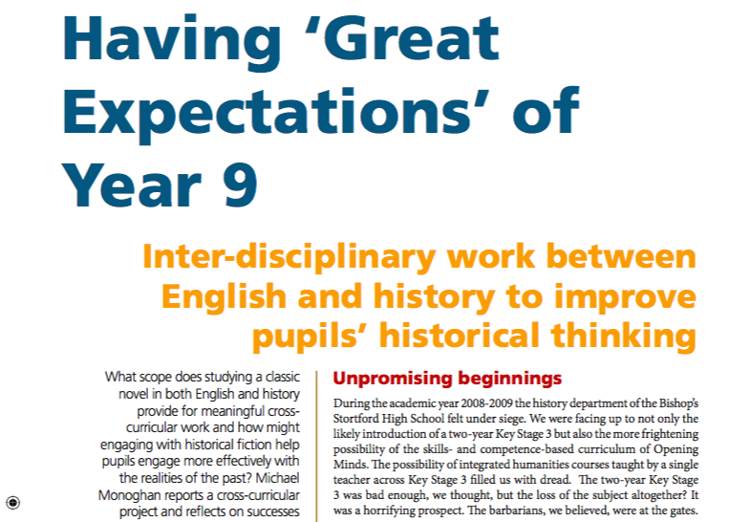
Monaghan, M. (2010) Teaching History 138

Slide 18
What the department had objected to most … was the loss of rigour. We felt that this ‘new’ cross-curricularity, with its anti-subject rhetoric and its false distinction between competences and knowledge, would lead to watered-down teaching, generic thinking skills and the loss of any kind of intellectual framework. We believed in cross-curricularity, just not this kind of cross- curricularity. What we needed was a way of showing SMT that smart inter-disciplinary projects led by subject specialists were better. In other words, that teachers rooted in their own subjects as distinctive ‘ways of knowing’ could work together to improve the thinking of pupils in more powerful and profound ways than the emptiness of a competence-driven approach. The competence approach advocated by SLT ignored the role of secure content in making thought possible and ignored the disciplinary ways of thinking critically we were already teaching.
Monaghan, M. (2010) Teaching History 138

Slide 19
5. What is the relationship between the academic discipline and the school subject?
(or how does ‘recontextualisation’ happen in this subject?)

Slide 20
How many times has SLT supported, encouraged or required your dept to:
read historical scholarship;
discuss historical scholarship regularly as a departmental activity;
devote an inset day either to hearing one or more historians speak, or to reading and discussing historical scholarship;
explain the relationship between your curriculum workschemes or progression models and characteristics of historical scholarship.

Slide 21
Why does continued connection with the academic discipline matter?
substantive historical knowledge;
renew, refine our understanding of the disciplinary aspects of the subject;
renew our enthusiasm and passion for the subject, and our ability to convey it;
mine real historical debates for better enquiry questions
find real historical scholarship that we can use with students in class (‘Interpretations’, anyone?)

Slide 22
The missing underlying senior leadership knowledge re: whole curriculum
Basil Bernstein:
A: in academe – “intellectual production of knowledge”
B: in schools – “educational reproduction of knowledge”
A becomes B through a process of recontextualisation

Slide 23
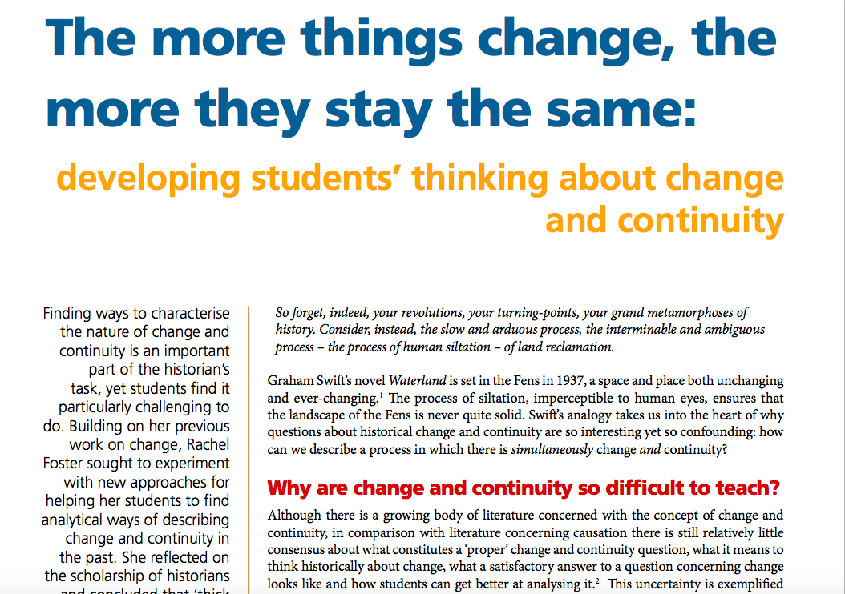
Foster, R. (2013) in TH 151

Slide 24
The missing underlying senior leadership knowledge re: whole curriculum
Basil Bernstein:
A: in academe – “intellectual production of knowledge”
B: in schools – “educational reproduction of knowledge”
A becomes B through a process of recontextualisation

Slide 25
5. What is the relationship between the academic discipline and the school subject?
SLT needs to know:
why reading historical scholarship matters;
that the work of planning in history is an ongoing work of recontextualising the discipline;
that much subject-specific CPD is the collective ongoing work of recontextualising the discipline;
that heads of history need to read works by other history teachers who have contributed to the collective recontextualisation – e.g. crucial defining work by Rachel Foster on the kind of argument that taking place when pupils tackle change/continuity enquiry questions;
that the academic discipline isn’t just mediated by other people (the NC, exam boards, textbooks); rather, that mediation is the everyday professional and scholarly responsibility of the ordinary history teacher, working with other history teachers either directly or through publications;
that the relationship between subject and discipline is different from subject to subject, and this affects planning, CPD, assessment, everything.

Slide 26
6. How do sequences of lessons work in this subject?
(…and why and why this matters so much)
See Workload Challenge report on ‘Planning and Resources’!

Slide 27
What does SLT need to know?
1. The indirect manifestation of knowledge
2. Is this subject issue disciplinary or substantive?
3. Is this subject’s structure cumulative or hierarchical?
4. Intelligent inter-disciplinarity v. crazy cross-curricularity
5.Recontextualisation of the academic discipline as school subject
6. How lesson sequences work

